Slide 1
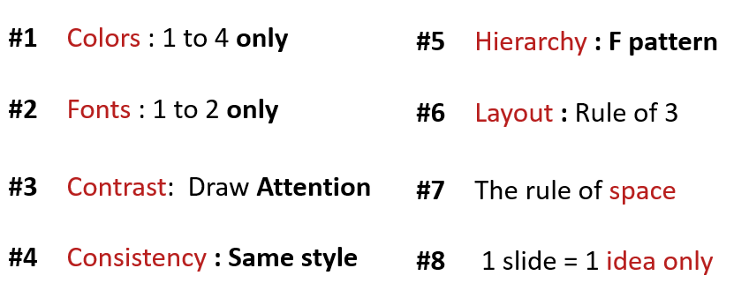
ACTIVITY 2
Analyze the problems on the slides
What is not useful ?
Which rule is not valid?
Improve the slides to fix the problem

Slide 2
Quiz-app G-7
MSK
AGENDA
1. THE SELLER
KEA NHOR
2. THE TECH
SOPHAL SARARN
3. THE MANAGER
MENG MAO

Slide 3

Quiz-app G-7
The Manager
MSk
3 What your team need to improve?
Improve communication & time management
Improve researching skills & responsibility
Improve discussing & solidarity

Slide 4
What is not useful ?
have 3 fonts
have alot style (font Title)
have 5 color on font style.
2. Which rule is not valid?
Font. It have 3 font.

